Slide 2
Independence
1
Bathroom
2
Communication
3
Lunch
All functions of using the potty
Changing Clothes
Shoes
Express wants and needs
Ask questions and seeks help when needed
Bring a Lunch OR Buy a Lunch.
Practice Lunch Number
Easy Opening Items
Parents can come have lunch

Slide 3
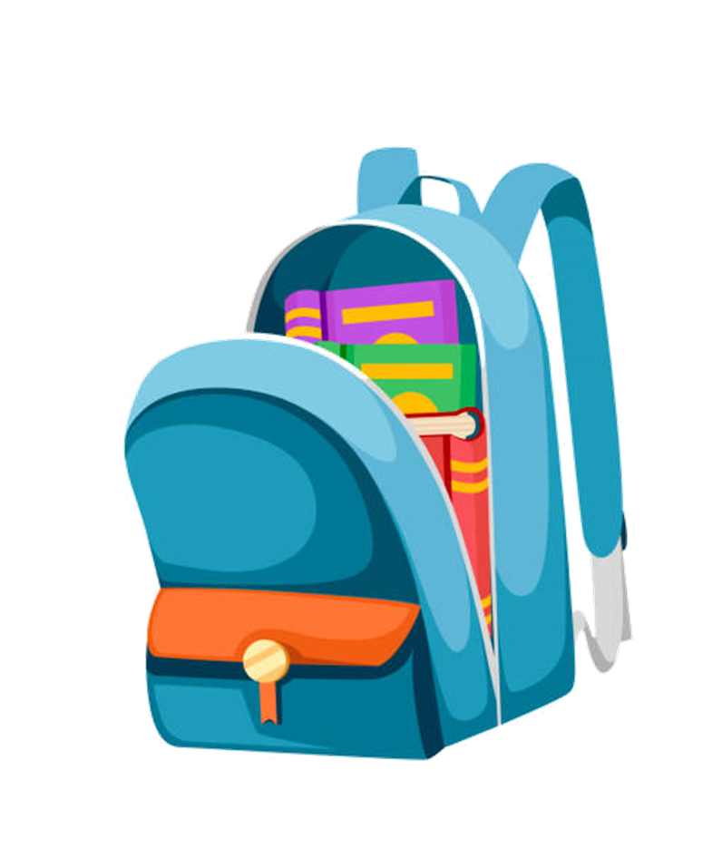
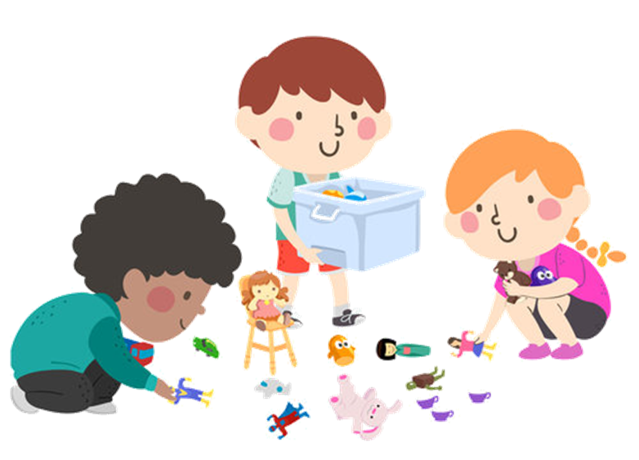
Independence
1
Backpacks
2
Cleaning Up
3
Attending to a Task
Packing & Unpacking
Zipping & Unzipping
Taking care of materials appropriately
Putting things away in their correct places
Staying on task for at least 15 minutes
Completing assignments timely
Working independently
Self Control

Slide 4
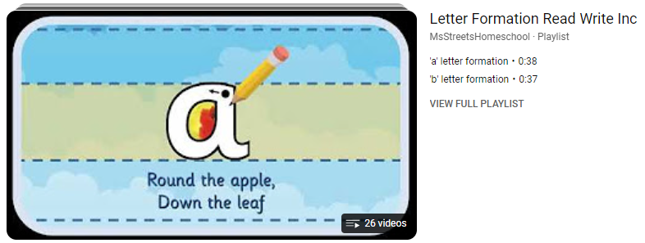
Grip
Scissors
Name Writing
Letter Formation
Number Formation

Slide 5
Kindergarten Readiness Foundations of School Success
Makes statements and appropriately answers questions about how objects/materials can be used to solve problems.
Engages in independent activities and continues tasks over a period of time.
Uses senses to observe, classify, and learn about objects and environment.
Performs fine motor tasks that require small muscle strength and control.
Effectively uses words, sentences and actions to communicate needs, ideas, opinions and preferences.
Independently follows rules and routines.
Plays cooperatively with a few peers for a sustained period of time.

Slide 6
Kindergarten Readiness English Language Arts
Listens and differentiates between sounds that are the same and different.
Recognizes and names some upper case letters of the alphabet.
Recognizes and names some lowercase letters of the alphabet.
Tracks words from left to right, top to bottom, and page to page.
Draws pictures and copies letters and/or numbers to communicate.
Listens to and follows multi-step directions.
Uses spoken language that can be understood with ease.
Uses writing tools.

Slide 7
Kindergarten Readiness Math
Recites numbers up to 20 in sequence.
Counts at least 10 objects using one-to-one correspondence.
Recognizes numerals.
Sorts and classifies objects using one or more attributes or relationships.
Recognizes and names common two-dimensional shapes.
Uses writing tools.

Slide 8
Need to Knows
1
Attendance
2
Breakfast
3
Communication
All absences require a note
Notes must be submitted within 3 days after the absence
Parent Notes : 3 maximum per Semester
Doctors Notes : Unlimited
After 5 unexcused absences, these absences will be reported to the truancy officer
The tardy bell rings at 8:00 AM
Please have them dropped off by 7:40 so that they will have time to eat and be ready for learning at 8:00
Sometimes kids may eat breakfast at home with you and then when they come to school
Email
Phone Calls
Class Dojo- teachers will communicate to parents using Dojo and communication folders that will go home daily

Slide 9
Need to Knows continued
4
Digital Learning Days
5
Behavior
6
Daily Send Ins
Assignments will be loaded on Canvas
Friday, August 9, 2024
Friday, August 30, 2024
Friday, October 4, 2024
Tuesday, November 5, 2024
Friday, January 17, 2025
Friday, March 7, 2025
Each teacher will clarity behavior expectations at the beginning of the school year.
Behavior chart in the folder. Please sign it daily.
Communiation Folder
Sign behavior daily
Snack (Nothing spicy, please)
Water Bottle (No colored drinks please)

Slide 10
Need to Knows continued
7
Lunch
8
Take Home Folder SEND IN DAILY
Bring a Lunch OR Buy a Lunch.
Practice Lunch Number
For packed lunches, please be sure that they are easily able to open everything in there
You can eat lunch with your child, but only with your child/children. Students’ friends cannot sit with you.
This will take place in the lobby at the round tables.
All money goes here. This includes:
Lunch Money
Field Trip Money
Book Fair Money, etc…
Much of the money will be handled on RevTrak
All notes go here

Slide 11
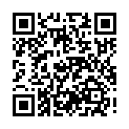
Scan the QR Code

